Slide 1

2025 STAFF PERFORMANCE EVALUATION TRAINING

Slide 2
TRAINING OBJECTIVES
Understand the purpose and importance of performance evaluations
Identify what makes an evaluation effective and defensible
Apply best practices when rating and commenting on performance
Avoid common mistakes that create confusion or risk
Use evaluations as a tool for accountability and development

Slide 3
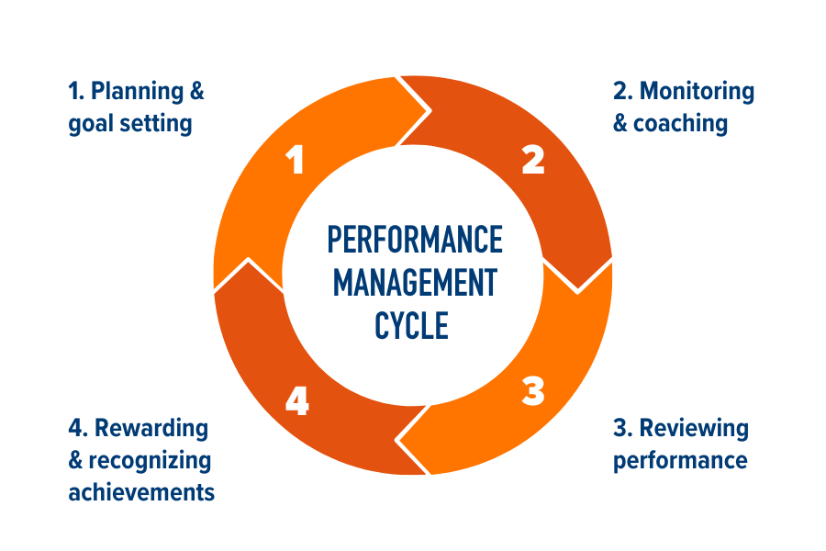
PERFORMANCE MANAGEMENT CYCLE
Source: Quantum Workplace

Slide 4
5 OBJECTIVES OF PERFORMANCE REVIEWS
Clarify expectations and performance standards so employees understand what success looks like in their role.
Provide constructive, objective feedback on performance, with no surprises.
Recognize accomplishments and contributions that support departmental and institutional goals.
Identify areas for improvement and development needs to support employee growth and effectiveness.
Document performance to support consistent, fair employment decisions, including merit, corrective action, and career planning.

Slide 5

TIPS FOR MANAGERS
DO’S:
Provide ongoing feedback so performance issues and successes are addressed throughout the year.
Set clear goals and expectations early so employees understand priorities and standards.
Connect roles to department and university goals to reinforce purpose and impact.
Evaluate the full review period rather than focusing on isolated events.
Use specific, objective examples to clearly support ratings.
Apply standards consistently across your team to ensure fairness
Engage employees in conversation to promote understanding and accountability.
DONT’S
Don’t wait until the annual review to address performance concerns.
Don’t rely on memory alone when completing evaluations.
Don’t allow recency bias to influence ratings.
Don’t use vague or subjective language.
Don’t inflate ratings to avoid difficult conversations.

Slide 6
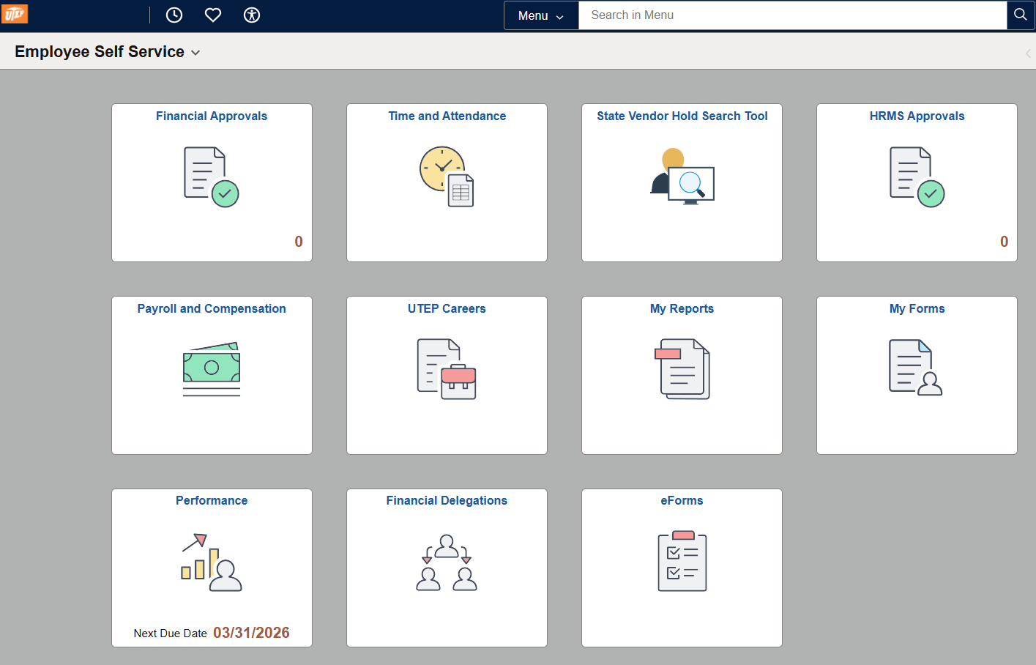
EMPLOYEE SELF-SERVICE VIEW
Performance Tile
View Your Historical Documents

Slide 7
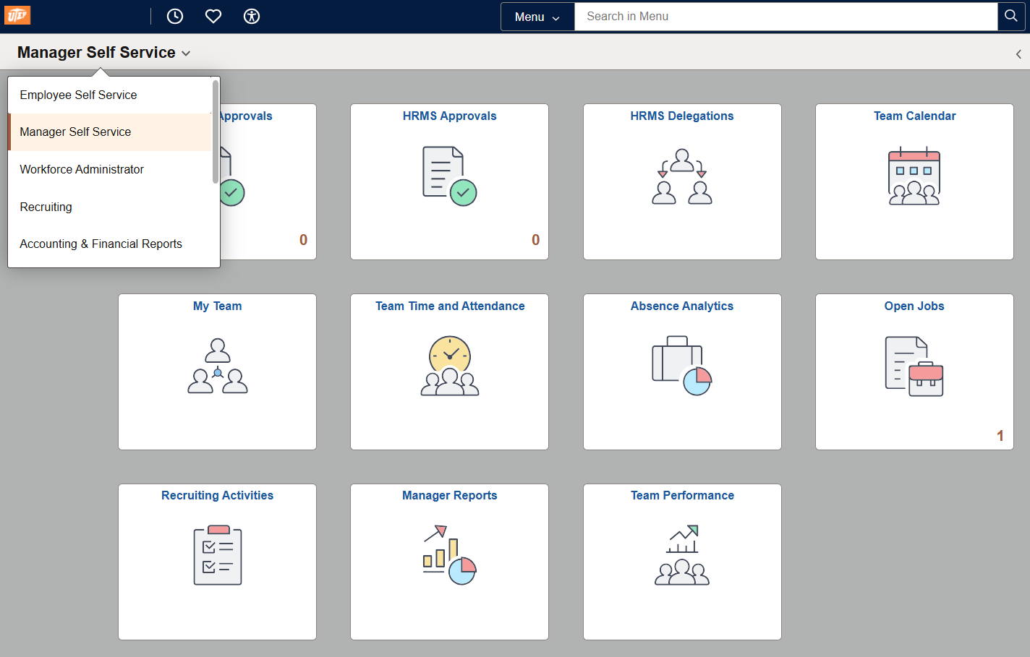
MANAGER SELF-SERVICE VIEW
Team Performance Tile
Current Documents
Historical Documents (Manager)
Approve Documents (Manager)

Slide 8

KEY ROLES IN EVALUATION PROCESS
Employee
The individual being evaluated. Has the opportunity to complete self-evaluation.
Manager
Conducts the evaluation. Provides direct feedback on performance goals.
Second-Level Manager
Reviews evaluations completed by manager. Ensures alignment with organizational vision and expectations. Offers feedback to managers to refine goals and direction.

Slide 9
2025 STAFF PERFORMANCE EVALUATIONS
DEMO

Slide 10
E-PERFORMANCE – 2025 EVALUATION STEPS
Step 1: Manager Accesses PeopleSoft
Utilize ‘MANAGER SELF-SERVICE’
Step 2: Manager Defines Goals
This step requires managers to add Goals if they were not added at the beginning of 2025
Optional: Update/define Competencies for 2025 Evaluation
Submit Goals (2025 Goals must be submitted to unlock 2025 evaluation)
Optional: Employee Completes Self-Evaluation
Employee Completes Self-Evaluation to include Feedback/Comments on Goals, Ratings on Competencies
Manager may continue to Step 3 even when employee has not completed self-evaluation
Step 3: Manager Completes Evaluation
Initiate 2025 Evaluation by giving feedback on goals
Add ratings and comments to Competencies under each Criteria
Identify Strengths and Challenges
Provide Overall Summary
Submit Evaluation to Next Level Supervisor for approval
Next Level Supervisor Denies or Approves
Optional: Manager Schedules One/One
Schedule one-on-one with employee after 2025 Evaluation is completed
Discuss Goals given for 2026
Step 4: Manager Requests Acknowledgement
Update status on evaluation to Share with Employee
When sharing document with employee manager is Requesting Acknowledgement
Step 5: Employee Acknowledges
Employee may add comments
Evaluation is marked as Complete when employee sets status to Acknowledged
Evaluation available under ‘Historical Documents’

Slide 11
RATINGS
Performance Rating | Performance Rating Definitions
Exceptional (5) | Consistently exceeds goals and expectations. Demonstrates superior performance and routinely performs at a level above current responsibilities. Results have a substantial impact beyond individual role and team, impacting the department, unit and/or University. Performance at this level occurs throughout the year. Consistently demonstrates behaviors beyond competency expectations.
Exceeds Expectations (4) | Consistently meets and frequently exceeds goals and expectations. Delivers results that are beyond the scope of the current role and responsibilities. Produces results that involve extra, unique or innovative contributions and solutions. Frequently demonstrates behaviors within and above competency expectations.
Meets Expectations (3) | Consistently meets goals and expectations and may exceed one or more expectations. Meets the expectations for the role and for the team. Delivers important and valuable results throughout the year. Models behaviors within competency expectations.
Needs Improvement (2) | Meets expectations for some objective but has not met all performance objectives and behavioral expectations. Acceptable performance in some areas but needs improvement in other areas. Performs basic position duties and responsibilities, needs continued development in order to fully perform to expectations. A performance plan is recommended.
Unsatisfactory(1) | Does not meet most goals or expectations. Did not achieve expected overall results during the past year. Performance frequently fails to meet minimum requirements and expectations. Significant improvement required. Immediate action is required to improve performance and/or behavior.

Slide 12
MANAGER TAKEAWAYS
Performance evaluations directly impact merit eligibility and other employment decisions.
Timely, accurate evaluations are a supervisor responsibility, not an optional task.
Ratings and comments must be supported by clear, objective examples.
Inconsistent or incomplete evaluations create risk for both the manager and the university.
Well-documented evaluations support fairness, transparency, and accountability.

Slide 13
QUESTIONS?
THANK YOU!
EMPLOYEERELATIONS@UTEP.EDU
Notes:
Section Header. Use this slide for sections.

